Slide 1
6G4Z0024 Web Development Lecture 7: Regular expressions
Yanlong Zhang
Y.Zhang@mmu.ac.uk

Slide 2
Learning Objectives
Regular expressions

Slide 3
Influences on JavaScript
Perl: regular expressions
Historic note: Perl was a horribly flawed and very useful scripting language, based on Unix shell scripting and C, that helped lead to many other better languages.
PHP, Python, Ruby, Lua, ...
Perl was excellent for string/file/text processing because it built regular expressions directly into the language as a first-class data type. JavaScript wisely stole this idea.

Slide 4
What is a regular expression?
/[a-zA-Z_\-]+@(([a-zA-Z_\-])+\.)+[a-zA-Z]{2,4}/
regular expression ("regex"): describes a pattern of text
can test whether a string matches the expr's pattern
can use a regex to search/replace characters in a string
very powerful, but tough to read
regular expressions occur in many places:
text editors (TextPad) allow regexes in search/replace
languages: JavaScript; Java Scanner, String split
Unix/Linux/Mac shell commands (grep, sed, find, etc.)
Notes:
4

Slide 5
String regexp methods
.match(regexp) | returns first match for this string against the given regular expression; if global /g flag is used, returns array of all matches
.replace(regexp, text) | replaces first occurrence of the regular expression with the given text; if global /g flag is used, replaces all occurrences
.search(regexp) | returns first index where the given regular expression occurs
.split(delimiter[,limit]) | breaks apart a string into an array of strings using the given regular as the delimiter; returns the array of tokens

Slide 6
Basic regexes
/abc/
a regular expression literal in JS is written /pattern/
the simplest regexes simply match a given substring
the above regex matches any line containing "abc“
for /abc/
YES : "abc", "abcdef", "defabc", ".=.abc.=."
NO : "fedcba", "ab c", "AbC", "Bash", ...
Notes:
6

Slide 7
Wildcards and anchors
. (a dot) matches any character except \n
/.oo.y/ matches "Doocy", "goofy", "LooPy", ...
use \. to literally match a dot . character
^ matches the beginning of a line; $ the end
/^if$/ matches lines that consist entirely of if
Notes:
Answer:
egrep "\<C\>" ideas.txt
egrep "^ACT|^Scene" hamlet.txt

Slide 8
String match
string.match(regex)
if string fits pattern, returns matching text; else null
can be used as a Boolean truthy/falsey test: if (name.match(/[a-z]+/)) { ... }
g after regex for array of global matches
"obama".match(/.a/g) returns ["ba", "ma"]
i after regex for case-insensitive match
name.match(/Marty/i) matches "marty", "MaRtY"

Slide 9
Special characters
| means OR
/abc|def|g/ matches lines with "abc", "def", or "g"
precedence: ^Subject|Date: vs. ^(Subject|Date):
There's no AND & symbol. Why not?
() are for grouping
/(Homer|Marge) Simpson/ matches lines containing "Homer Simpson" or "Marge Simpson"
\ starts an escape sequence
many characters must be escaped: / \ $ . [ ] ( ) ^ * + ?
"\.\\n" matches lines containing ".\n"
Notes:
9

Slide 10
Quantifiers: * + ?
* means 0 or more occurrences
/abc*/ matches "ab", "abc", "abcc", "abccc", ...
/a(bc)*/" matches "a", "abc", "abcbc", "abcbcbc", ...
/a.*a/ matches "aa", "aba", "a8qa", "a!?_a", ...
+ means 1 or more occurrences
/a(bc)+/ matches "abc", "abcbc", "abcbcbc", ...
/Goo+gle/ matches "Google", "Gooogle", "Goooogle", ...
? means 0 or 1 occurrences
/Martina?/ matches lines with "Martin" or "Martina"
/Dan(iel)?/ matches lines with "Dan" or "Daniel"
Notes:
Answer:
egrep "\^_*\^" chat.txt

Slide 11
More quantifiers
{min,max} means between min and max occurrences, inclusive.
/a(bc){2,4}/ matches lines that contain "abcbc", "abcbcbc", or "abcbcbcbc"
min or max may be omitted to specify any number
{2,} 2 or more
{,6} up to 6
{3} exactly 3
Notes:
11

Slide 12
Character sets
[ ] group characters into a character set; will match any single character from the set
/[bcd]art/ matches lines with "bart", "cart", and "dart"
equivalent to /(b|c|d)art/ but shorter
inside [], most modifier keys act as normal characters
/what[\.\!\*\?]*/ matches "what", "what.", "what!", "what?**!", ...
Exercise : Match letter grades e.g. A+, B-, D.
Notes:
Answer:
egrep "[ABCDF][+\-]?" 143.txt

Slide 13
Character ranges
inside a character set, specify a range of chars with -
/[a-z]/ matches any lowercase letter
/[a-zA-Z0-9]/ matches any letter or digit
an initial ^ inside a character set negates it
/[^abcd]/ matches any character but a, b, c, or d
inside a character set, - must be escaped to be matched
/[\-+]?[0-9]+/ matches optional - or +, followed by at least one digit
Exercise : Match phone numbers, e.g. 0161-247-1530 .
Notes:
Answer:
egrep "[0-9]{3}-[0-9]{3}-[0-9]{4}" faculty.html

Slide 14
Built-in character ranges
\d any digit; equivalent to [0-9]
\D any non-digit; equivalent to [^0-9]
\s any whitespace character; [ \f\n\r\t\v...]
\S any non-whitespace character
\w any word character; [A-Za-z0-9_]
\W any non-word character
/\w+\s+\w+/ matches two space-separated words

Slide 15
Regex flags
/pattern/g global; match/replace all occurrences
/pattern/i case-insensitive
flags can be combined:
/abc/gi matches all occurrences of abc, AbC, aBc, ABC, ...

Slide 16
Back-references
text "captured" in () is given an internal number; use \number to refer to it elsewhere in the pattern
\0 is the overall pattern,
\1 is the first parenthetical capture, \2 the second, ...
Example: "A" surrounded by same character: /(.)A\1/
variations
(?:text) match text but don't capture
a(?=b) capture pattern b but only if preceded by a
a(?!b) capture pattern b but only if not preceded by a
Notes:
Answer:
sed -r "s/([0-9]{3})-([0-9]{3})-([0-9]{4})/(\1) \2.\3/g" facnames.txt

Slide 17
Working with RegExp

Slide 18
Regex syntax
^ $ . | { } [ ] ( ) * + ? \
Literal Characters
(metacharacters)

Slide 19
provide a list of potential
matching characters at a
position in the search text
7[Pp][Mm]
Square Brackets

Slide 20
What are these ?
7[Pp][Mm] [1-9][aApP][Mm] [1-9][aApP][Mm]

Slide 21
repetition of characters
{n} : “n” times.
{n,} : At least “n” times, but no upper
limit.
{n,m} : Between “n” and “m” times.
Curly Brakets

Slide 22
Repetition characters
Quantifier | Matches | Same as
? | Match zero or one time | {0,1}
* | Match zero or more times | {0, }
+ | Match one or more times | {1, }
Quantifier Symbols

Slide 23
[abc]
A single character: a, b, or c

Slide 24
[^abc]
Any single character but a, b, or c

Slide 25
[a-z]
Any single character in the range
a-z

Slide 26
[a-zA-Z]
Any single character in the range a-z or A-Z

Slide 27
^
Start of line

Slide 28
$
End of line

Slide 29
\s
Any whitespace character

Slide 30
\S
Any non-whitespace character

Slide 31
\d
Any digit

Slide 32
\D
Any non-digit

Slide 33
\w
Any word character (letter, number, underscore)

Slide 34
\W
Any non-word character

Slide 35
(abc)
Capture 'abc’ enclosed

Slide 36
(a|b|c)
= [abc]
a or b or c

Slide 37
i
Case insensitive option.

Slide 38
x
ignore whitespace in regex

Slide 39
?=
?= is a positive lookahead, a type of zero-width assertion. What it's saying is that the captured match must be followed by whatever is within the parentheses but that part isn't captured.

Slide 40
?=.*<pattern>
the captured match must be followed at least once

Slide 41
Complicated examples

Slide 42
email
Starting with an id, which can be letter or number or underscore or ‘-’
A @
String(s)
A .
2-4 characters
/^[a-zA-Z0-9_\-]+@[a-zA-Z_\-]+\.[a-zA-Z]{2,4}$/

Slide 43
password
6 to 20 characters length
at least one uppercase char
At least one lowercase char
At least one number
At least one special char from the following:
%, ^, &, *, (, ), -, +
/^(?=.*[a-z])(?=.*[A-Z])(?=.*[0-9])(?=.*[\%\^\&\*\(\)\-\+]).{6,20}$/

Slide 44
Master-card number
16 digits
Starting with 51, 52, 53, 54, 55 or 2221-2720
5100-5599
2221-2720
2221-2229
2230-2299
2300-2699
2700-2719
2720
/^((5[1-5][0-9]{2})|(222[1-9])|(22[3-9][0-9])|(2[3-6][0-9]{2})|(27[01][0-9])|2720)[0-9]{12}$/

Slide 45
Master-card number*
16 digits
Starting with 51, 52, 53, 54, 55
/^(5[1-5][0-9]{14}$/

Slide 46
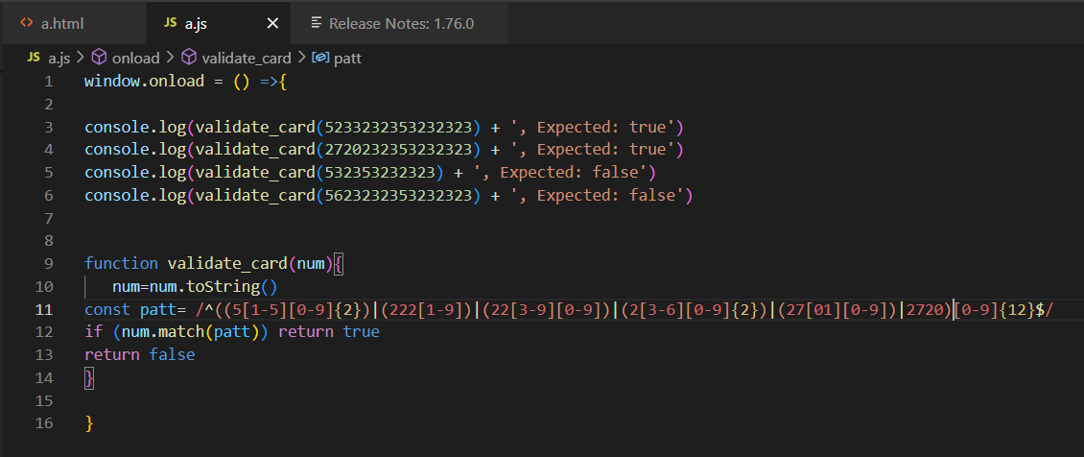
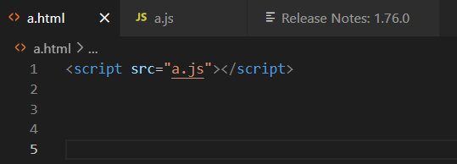
An example

Slide 47
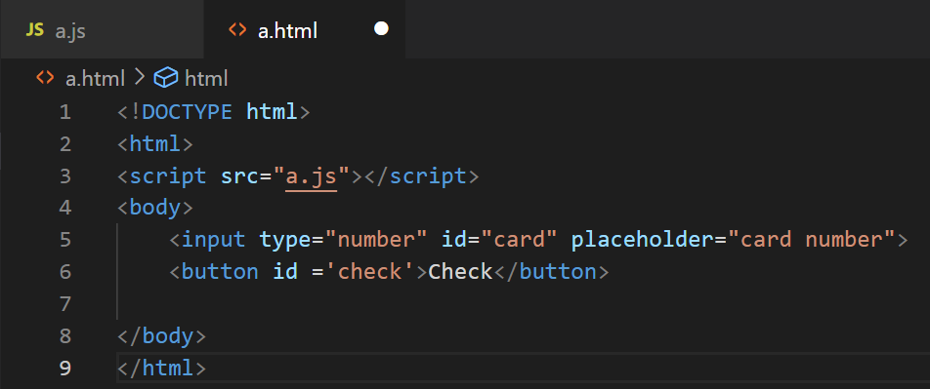
Another example

Slide 48
